Slide 1
Everyday Use of GNU GUIX
https://www.youtube.com/watch?v=0berTO7d6gg&t=1971s

Slide 2
Scenario – I wonder how GNU Hello is build
Scenario: I Paint some art. What can I use
Commands
  Get Source Code: guix build –source hello
  Get dependencies – guix environment hello
  Find packages related to painting : guix package –search=painting
  Refine search: recsel -e ‘description’ ~ “professional”
Option
  --pure – Eliminates all environment variables except ones in the package definition

Slide 3
Guix: Dependable
Commands
Hackable
Transactional Happens all the way or not at all
Unprivileged Root is not need to install packages
Exact Dependencies
Transparent source/binary deployment If not available on the servers will fetch from source and compile
Commands
  Install Software : guix package –install krita -- fetch a prebuilt substitute of the software
  Uninstall: guix package –roll-back ; guix package –remove krita
  View package definition: guix edit krita
  Upgrade / roll-back Guix itself
  Visualize Dependencies : guix graph
  Build packages : get their source
  Safely remove unused software : guix gc
  emacs-guix – Emacs interface to Guix : https://emacs-guix.gitlab.io/website
Hackable
  As a tool ( CLIs):
    Package, customize, share any software
  As a library ( APIs ) -- Build new software management tools

Slide 4
How does Guix work
guix package -i hello ( unprivleged client)
  Send a request to build hello over UNIX Domain socket to the guix-daemon ( runs as root user )
    Builds the code in isolated environment as an unprivileged user ( only the dependencies declared are available for the build )
    Result is copied into the Store ( immutable only daemon can write to it )
      A directory in the file systems
The Functional Model – Building the software is just a function
  Inputs → Function → Output
  Example
    Inputs: gcc, libc, source
    Function: ./configure ; make ; make test ; make install
    Output: hello ( binary ) stored in /gnu/store
      Each file has a pattern-<name>-version
        Pattern – Cryptographic Hatch
      Same inputs – Same pattern and name
      Different inputs – Different pattern

Slide 5
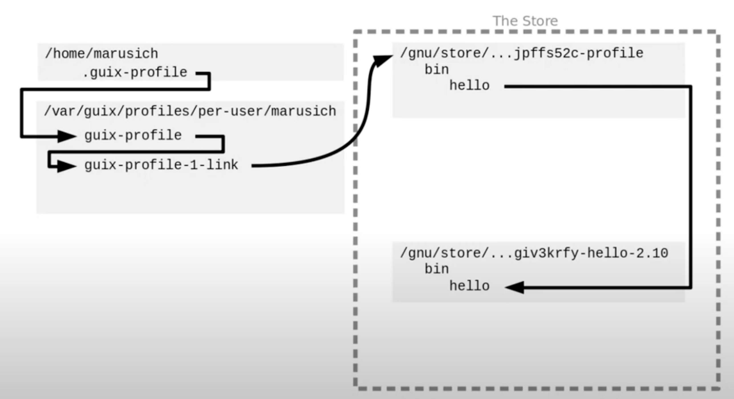
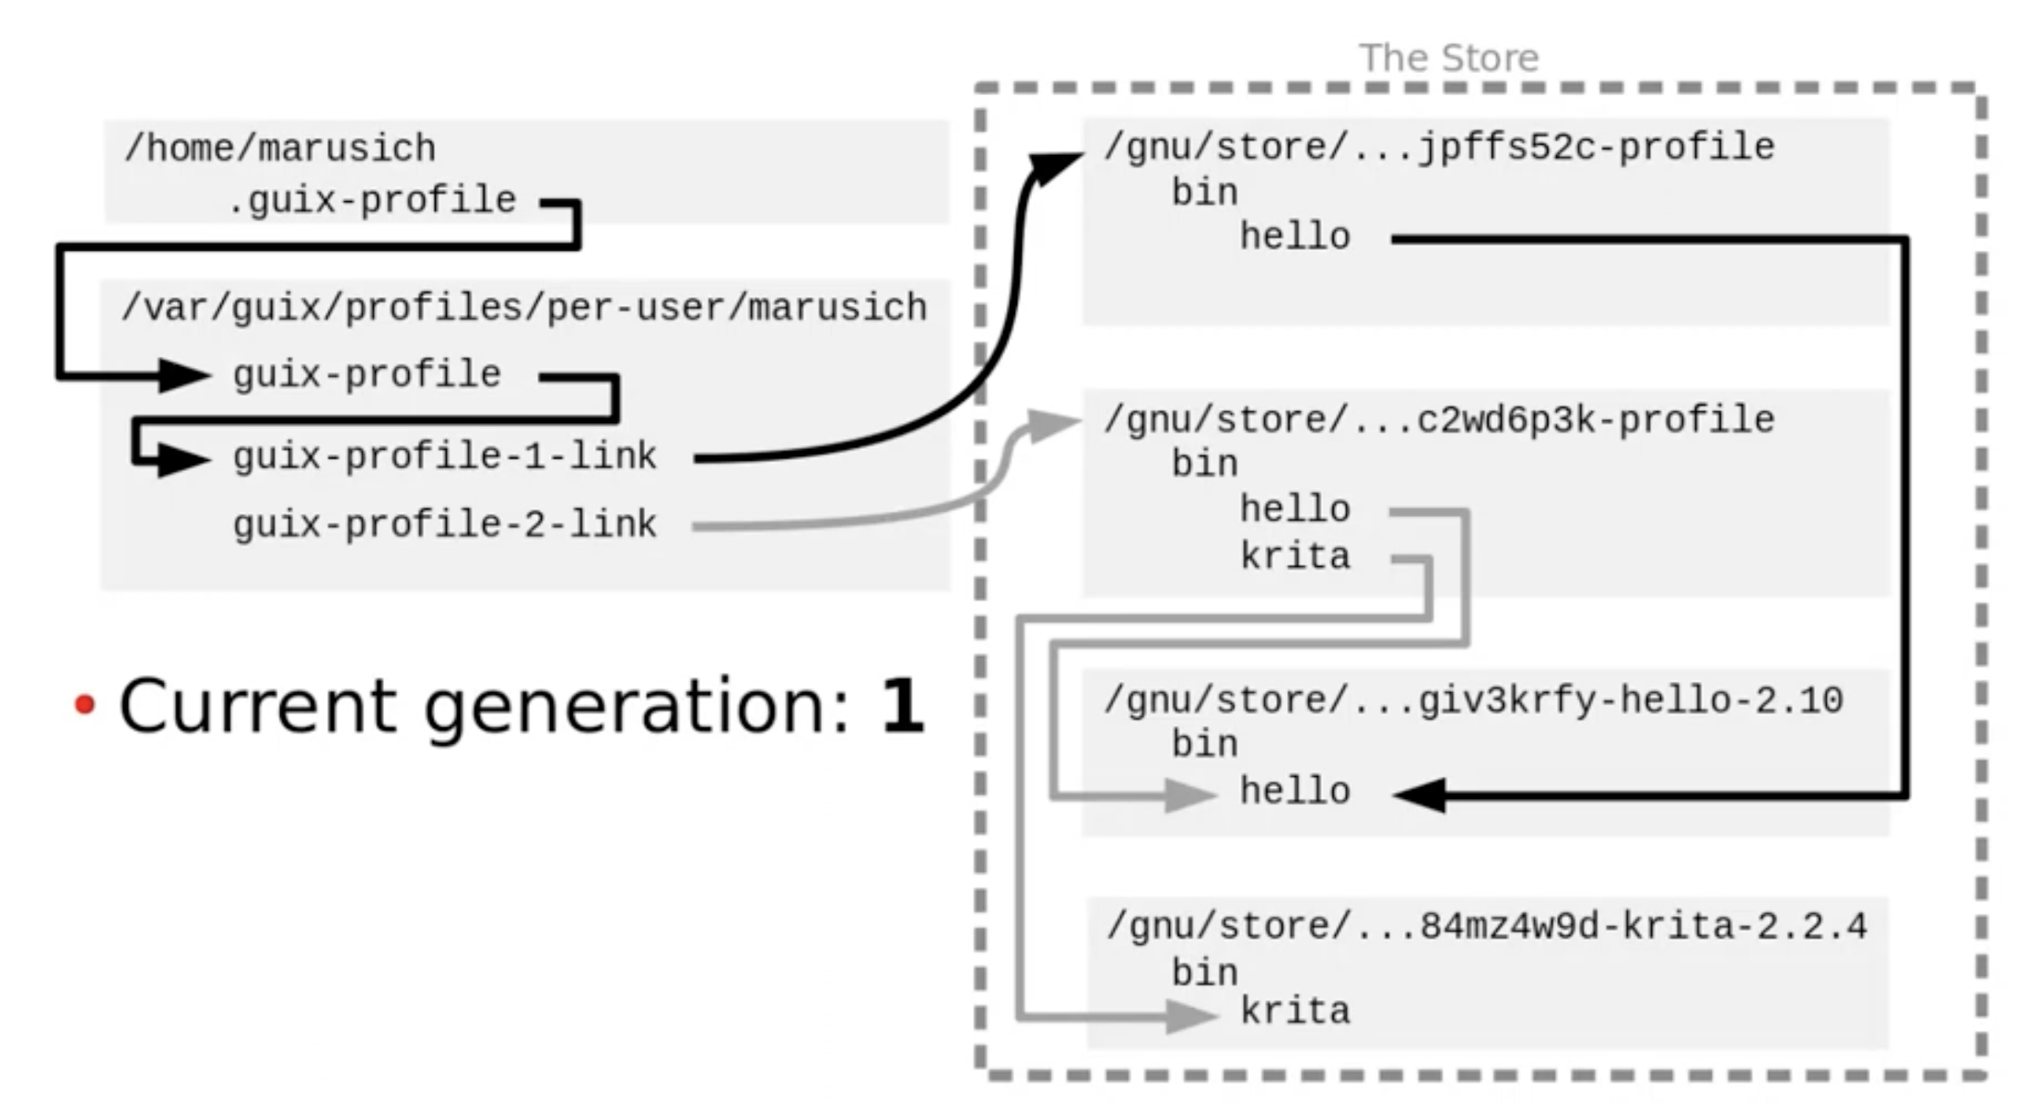
Profiles
Can run software directly from the store, but profiles can be used
Profiles – Directory containing symbolic links that point to software in the store.
  Guix will build this in the store
Guix build some external links too.
  Helps to make the software available
guix-profile-1-link
  1 is the first generation
Use a lot of symlinks so we can have many profiles
  Profiles are used for generation
First picture is when you add one executable and the second is when you
add another
--profile
guix-profile – Symlink flip is atomic. Generation 1 exist, but is not being used

Slide 6
Cleanup
guix package –delete-generations
  The symlinks are removes sot they can be safely deleted.
  guix gc – Delete items not be refereed to outside the store
Profiles/generations are GC Roots

